Slide 1

















Belleair elementary
Holly Huey & laura johnson
ANNUAL
TITLE I MEETING
August 27th 5:00 pm
Media center
25-26
Notes:
Evidence: Upload completed presentation and recorded feedback as part of the evidence to support the Annual Meeting Materials. Do not forget the sign-in sheets, and survey/feedback that you receive throughout the meeting. ​
*** CORRECT anything in RED to be your specific school ***

Slide 2



ALL ABOUT TITLE I
•Title I is the LARGEST federal assistance program for our nation’s schools
•The Program serves 95 schools in Pinellas County including students in 38 non-public schools
.
Notes:
Highlight the Title I Program here in Pinellas County.

Slide 3


TITLE I FUNDING PROCESS
2 FLORIDA DEPT. OF EDUCATION
3. PINELLAS COUNTY SCHOOLS
BELLEAIR ELEMENTARY
  FEDERAL GOVERNMENT
Notes:
REQUIRED
The Florida Department of Education receives funds from the federal government. Districts receive Title I funds from Department of Education, and the school district distributes these funds to schools based on the percentage of children eligible for free/reduced price lunch; however, students do not have to be from low-income families to receive help. ​

Slide 4

TITLE I SUPPLEMENTAL RESOURCES
DEFINITION: PROVIDED IN ADDITION TO WHAT IS ALREADY PRESENT OR AVAILABLE TO COMPLETE OR ENHANCE IT.
Notes:
REQUIRED
Title I is supplemental federal funding that provides e​
​
Definition: provided in addition to what is already present or available to complete or enhance it extra academic support and learning opportunities for economically disadvantaged students.

Slide 5

Title I Programs Provide Supplement Support
Supplemental Resources | Positive Impact
Additional supplement personnel (MTSS Coach, Two Interventionist, One Behavior Support) | Support for teachers and students, small group teaching to help students meet grade level expectation
Additional training opportunities for school staff (Data training) | Learning ways to use student assessment data to determine the best ways to reteach and support
Extended Learning Opportunities (before and/or after school programs) | Ways to extend the academic day and provide additional clubs
Parent and Family Engagement Resources and Training Workshops | Connections between school and home
Supplemental teaching materials equipment and technology | Academic programs for students
Notes:
OPTIONAL
Use additional slides if necessary. This is where you want to really highlight Title I funding and how it positively impacts your scholars! Additional supplemental personnel (add specific positions)​
If there are connections that they can make, they call it out!

Slide 6






LET’S CELEBRATE
BELLEAIR IS A B SCHOOL
Growth in overall proficiency for math (+8) and reading (+4)
Growth in learning gains for math (+10) and for L25 (+4)
Growth for SWD in ELA (+21)
Growth in proficiency in all but two subgroups in both ELA and math
Notes:
OPTIONAL
Based on the FSA data and school grades, there is a lot to celebrate!!​
How did your Title I Resources support or enhance the work that you were able to get done?

Slide 7



Title I
Schoolwide Planning and Input
First
Second
Last
Seek input from school, family and community members determine how Title I funds are used based on a needs assessment.
Please attend online or in-person meetings/trainings and complete surveys to provide input on Title I funding.
All Title I schools must document that parents are involved in the schoolwide planning process.
Notes:
REQUIRED
Evidence for input – input from school can be a survey or notes, which include quotes related to what was shared as feedback AND how this input will be used to inform the PFEP and future engagement activities. ​
​
Evidence of Attendance – please include attendance of DIVERSE stakeholder group/s.

Slide 8


TITLE I SCHOOLWIDE BUDGET
Belleair is provided $ 206,325 to pay for supplemental resources and programs for increased student achievement.
•Personnel
•Professional Development
•Curriculum Development and Data Analysis
•Technology Support
•Supplemental Instructional Materials and Resources
Notes:
REQUIRED
change all in red

Slide 9

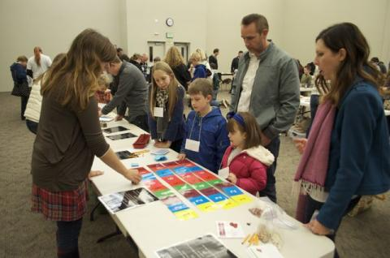
Belleair- Title I Parent & Family Engagement 2025-26 Budget
Total Allocation- $8,500
  Instructional Resources to Support Families $3,300
  Parent Training/Contracted Services $2,500
This Photo by Unknown Author is licensed under CC BY-SA-NC
Notes:
REQUIRED
SAMPLE ONLY - Delete Slide ​and make your own
Highlight your budget and resources and how they will be used to support family engagement.

Slide 10




PARENT’S RIGHT TO KNOW
Be provided information on your child’s level of achievement on assessments in Reading/Language Arts, Writing, Mathematics and Science
Be notified of non-highly qualified or out-of-field teachers at the school
Be informed if your child is taught by a non-highly qualified teacher for four or more consecutive weeks.
Request and receive information on the qualifications of your child’s teacher and supplemental personnel working with your child
Notes:
REQUIRED

Slide 11
Working Together for Student Success
SCHOOL
TITLE I
PARENT
SCHOOL
Title I Schoolwide Plan
Parent and Family Engagement Plan (PFEP)
School - Parent - Student Compact
School Improvement Plan (SIP)
Notes:
REQUIRED
As a Title I parent you have the right to be involved in the development of the following plans and documents for our school which can be found on our website (insert website) to view as well as in the Parent Station located (insert location here). ​
​Our school’s Title I Parent Station is located (insert location or photo of Title I Parent Station- front office and on the webpage). Please include photo as part of the evidence monitoring. ​
​You will find a copy of our School Improvement Plan, Title I Schoolwide Plan, School’s PFEP, the School District’s PFEP, Parent’s Right to Know Memo, Upcoming Events, Compact, (insert other documents at your station)​
​
School Improvement Plan (SIP)​
Parent and Family Engagement Plan ​
Title I Schoolwide Plan ​
School-Parent-Student Compact​
​

Slide 12

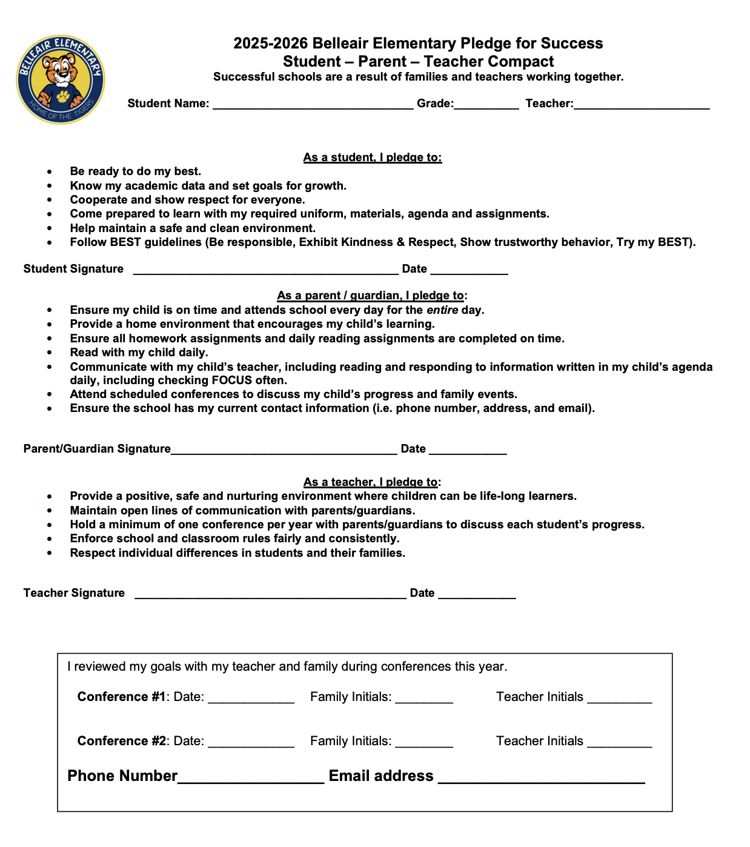

PARENT - SCHOOL - STUDENT
Compact
The Parent - School - Student Compact is updated every year to include parent, student, teacher and staff input. Parent, Student, Teacher and Staff comments are welcome at any time during the year.
The purpose of the compact is to foster student achievement. By signing the Parent - School - Student Compact, (insert name of school here), teachers, staff, parents and students agree to work together to share the responsibility of helping students meet or exceed state, district and school academic goals.
Please review and sign your child’s Compact.
Our GOAL is to receive 100% signed compacts!
Notes:
REQUIRED
At the elementary level, school compacts are used as a progress monitoring tool through the year during parent teacher conferences.

Slide 13

Parent and Family
Engagement Plan (PFEP)
The PFEP Sections include information about the following:
•Parent trainings to increase student achievement
•Staff trainings for engaging parents
•Communication methods between home and school
•Flexible meeting times
•Accessibility for parents
•Coordinating with other Federal Programs
Notes:
REQUIRED
Provide information on the specific committees that parents can be involved. Include the purpose, date and time of meetings. ​
Explain the PFEP and its purpose. ​
Consider the evidence related Title I Crate, Sample of Evidence,

Slide 14

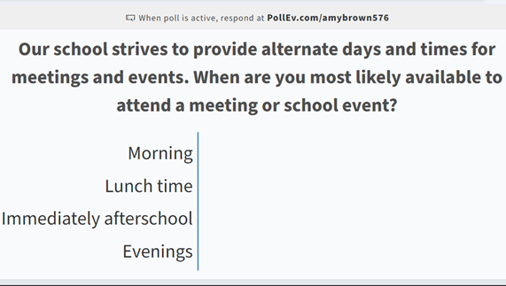
Opportunity for two-way communication
ENGAGEMENT TIP!!!
As mentioned in previous slide, the PFEP ensures to provide families with flexible meeting times.
Survey coming in weekly message in the next two weeks.
Notes:
OPTIONAL
Evidence – please keep this as evidence to support using feedback to inform flexible meetings.

Slide 15




Florida Benchmark for Excellent Student Thinking Standards (B.E.S.T). You may read more information by visiting, www.fldoe.org
FAST Assessment Grades 3-5
STAR Assessment Grades K-2
Three times a year
August/September
December
April/May
Notes:
REQUIRED
All curriculum, instruction and assessments are based on student-centered expectations.

Slide 16


School’s Curriculum
Florida Benchmark for Excellent Student Thinking Standards (B.E.S.T) form the framework of everything taught at school.
Core Curriculum:
•Reading
•Mathematics
•Writing
•Science
Notes:
REQUIRED
This slide is optional if this will be discussed with classroom teacher ​
School’s Curriculum​
Describe and explain the curriculum (Specific names of texts)​

Slide 17


Available Online at School Report Cards:
•School Grade and Overview
•Population and Enrollment
•Assessments- Academic Achievement, Growth, and Population
•Assessments -English Language Learners
•Graduation and Beyond
•Educator Qualifications and Equity
•Long-Term Goals and Interim Progress
•Accelerated Course Enrollment
•Per-Pupil Expenditures
•National Data
Available online at https://edudata.fldoe.org OR Front Office
Notes:
REQUIRED

Slide 18
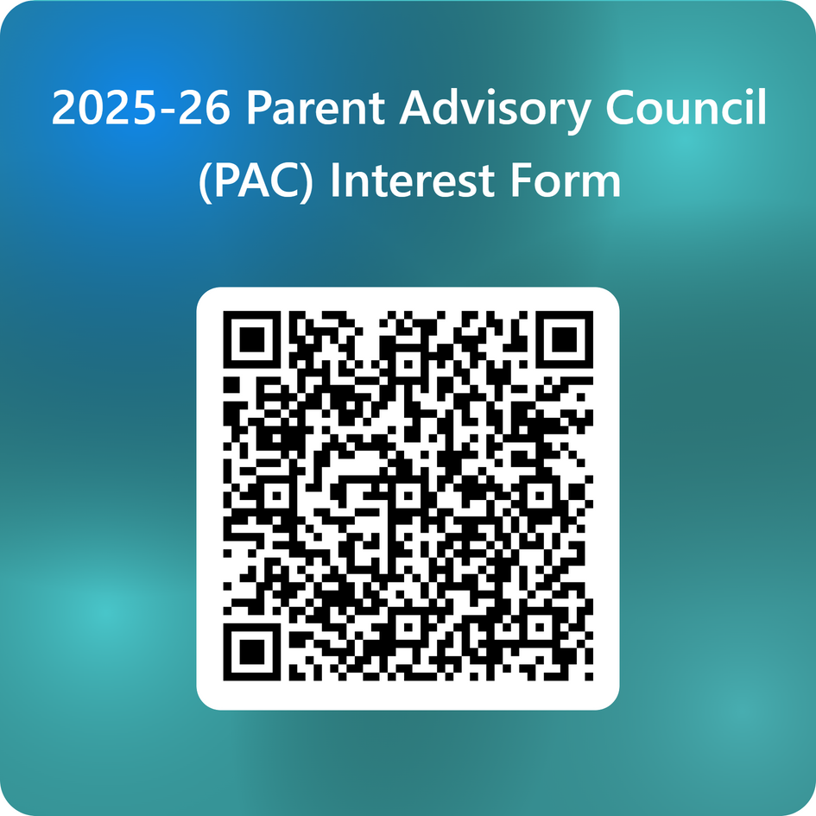
Parent Advisory Council (PAC)
•The district has a Parent and Family Engagement Plan. The summary of the plan is in the Title I School & Family Partnership Overview.
•You may access the full plan at www.pcsb.org/titleone
•The Parent Advisory Council (PAC) is responsible for reviewing and revising the District PFEP.
•PAC will meet virtually or in-person with the district’s Title I Staff.
•Each school is committed to having at least one member representing our school please notify, INSERT contact person
Notes:
REQUIRED
Please add your PAC representative in slide and share with your Title I Specialist. ​
​https://forms.office.com/Pages/ResponsePage.aspx?id=BZM8c9c5GkaGb_3ye_PH_ywWjljlMQdDv9wc58mKxfhUMlBCTlJTQkVCUkNDTjNIUTBaQTZSSDI1My4u

Slide 19

THANK YOU

